Slide 1

Trinity
International
College
Information Security and Cyber Law
Digital Society
Prashim Timsina
Sushan Gyawali
Sarun Balami

Slide 2


Digitalization
Digitization is the process of changing from analog to digital form, also known as digital enablement. Said another way, digitization takes an analog process and changes it to a digital form without any different-in-kind changes to the process itself.
Society
A society is a group of people participating in continuous social connection, or a broad social group occupying the same social or spatial territory, normally exposed to the same political power and cultural standards that are dominant.
Digital Society
What are Digitalization and society?
Definition and Explaination.

Slide 3
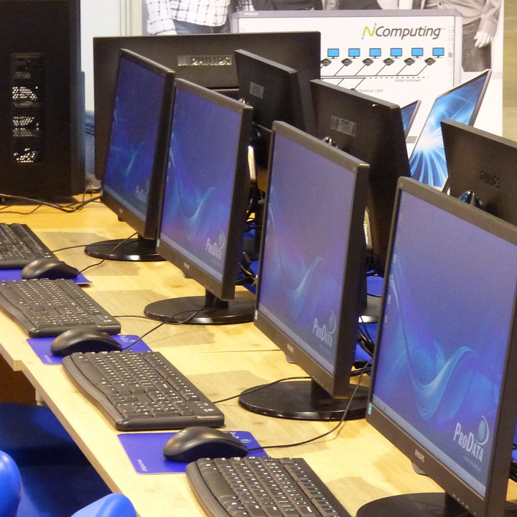
Trinity International College
An introduction to Digital Society
Briefing.
Digital society is the consequence of the adoption and integration of information and communication technology by the modern societies in their day to day activities, culture and lifestyles. It is not limited/bound to any geographical boundary. Digital society eases the imporovement of citizens lives and efficiency to many areas such as: health services, transportation, energy, agriculture , manufacturing, retail and public administration. Similarly, they can also imporve the governing process by helping the policy-makiers to take better decisions inclusive of citizens. Likewise, internet has considerable potential to promorte democracy, cultural diversity and human rights, say for example, freedom of expression and right to information
Introduction
Digital Society
Read More

Slide 4

Trinity International College
A digital society is an interdisciplinary research area and a kind of progressive society formed as a result of adaptation and integration of advanced technologies into the society and culture.
Definition of Digital Society

Slide 5
Digital Society
Trinity International College
Stakeholders
01. Content
02. Technologies
03. Society
It includes Data, Information, Knowledge, documentation
It includes software technology, communication technology, database technology, network technology, multimedia technology.
It includes a group of individuals living in a community in a particular geographical area/ territory

Slide 6
Trinity International College
Digital Society
Challenges of Digital society
We continue to move towards Digital Nepal. However, there are many issues acting as a barrier to stop or slow down the creation of a digital society. Following are some of the Challenges.
Challenge 1.
Challenge 3.
Lack of proper co-operation, co-ordination and collaboration among the stake-holders.
Unavailability and shortage of skilled manpower and Limited fund/budget for the work.
Challenge 2.
Challenge 4.
Little or no proper planning of digital product uses and their applicability in common people.
Lack of policy implementation Little or no infrastructure.
No encouraging initiatives from the government.
Less involvement of common people into the agenda

Slide 7
Trinity International College
Presentation on Digital Society
Thanks
Presented By:
Prashim Timsina
Sarun Balami
Sushan Gyawali

